Slide 1
EduVision DV
Higher Education Performance Dashboard
Tableau Data Visualization Project
TECHNOLOGY
DATASET
DASHBOARDS
Tableau • Python • Excel
850 universities • 33 fields
4 integrated dashboards
Project Presentation
Presented by: Fareen Mallik
EduVision DV • Higher Education Performance Dashboard
1

Slide 2
1. Project Overview
What EduVision DV is designed to achieve
PROJECT AIM
CORE ANALYSIS
FINAL OUTPUT
Transform university ranking and performance data into interactive insights for higher-education analysis.
Rankings, research performance, student diversity, academic reputation and country benchmarking.
A single Tableau workbook containing four interconnected dashboards.
Target users
Instruction alignment
• Students and academic researchers
• University administrators
• Education consultants and analysts
• Policy and benchmarking teams
• Interactive filters and drill-down
• Dashboard navigation and actions
• Six engineered education KPIs
• Testing, documentation and delivery
EduVision DV • Higher Education Performance Dashboard
2

Slide 3
2. Project Workflow
The complete project followed the milestone structure in the instruction document
M1
M2
M3
M4
Collect & Clean
→
KPI Engineering
→
Dashboard Development
→
Testing & Delivery
End-to-end flow
• Source data → cleaned Tableau-ready dataset
• KPI calculations → dashboard storyboard
• Four dashboards → global navigation and filters
• QA validation → final workbook and documentation
EduVision DV • Higher Education Performance Dashboard
3

Slide 4
3. Milestone 1 — Data Collection & Preparation
Weeks 1–2
DATA COLLECTION
DATA CLEANING
TABLEAU-READY OUTPUT
QS ranking data, World University Ranking data and university performance indicators were brought into a common structure.
Duplicates, university names, country names and ranking metrics were standardized for analysis.
The final analytical dataset was prepared for KPI calculation and Tableau visualization.
MY DATASET
KEY FIELDS
850 rows • 33 columns • 85 countries • Year 2024
QS rank • THE rank • overall scores • research scores • students • student/staff ratio • international students
Deliverables from the milestone
• Raw/cleaned university data
• Data preparation scripts/notebooks
• Final Excel dataset used for KPI engineering
EduVision DV • Higher Education Performance Dashboard
4

Slide 5
4. Milestone 2 — KPI Engineering
Weeks 3–4: converting raw metrics into meaningful indicators
Global Ranking Score
Research Impact Score
Faculty-to-Student Ratio
Combined ranking performance indicator
Research/citation performance indicator
Faculty capacity relative to students
International Student %
Academic Reputation Score
Research Productivity Index
Share of international students
Academic reputation measure
Research productivity indicator
Result: 6 education KPIs engineered and incorporated into the final dataset.
EduVision DV • Higher Education Performance Dashboard
5

Slide 6
5. Milestone 2 — Dashboard Planning & Prototype
Planning the four dashboards before final development
University Overview
Research Analytics
Rankings, global distribution, academic reputation and performance comparison
Publications/citations, research productivity and research impact
Student Analytics
Country Comparison
International students, diversity, enrollment and faculty-to-student analysis
Country ranking comparison and education performance benchmarking
Planning elements
Filters • Navigation • Dashboard actions • Interactive comparisons
EduVision DV • Higher Education Performance Dashboard
6

Slide 7
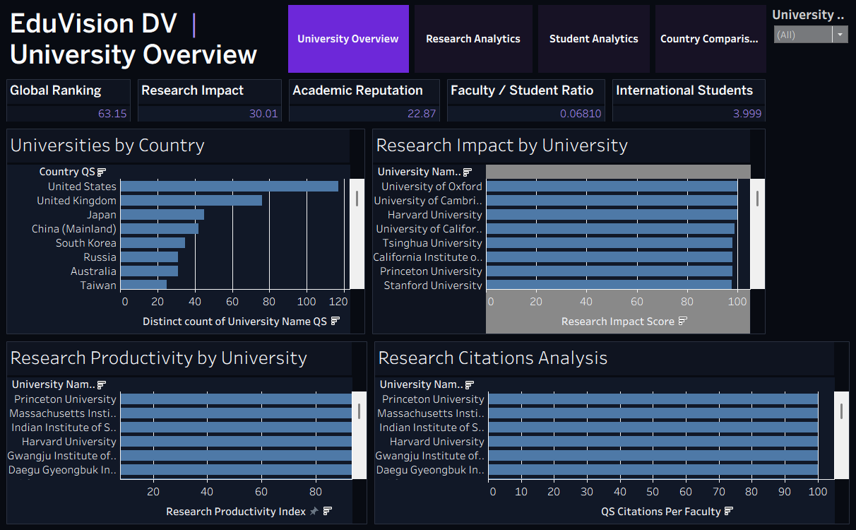
6. Milestone 3 — University Overview
Dashboard development: rankings, KPIs and institutional comparison
EduVision DV • Higher Education Performance Dashboard
7

Slide 8
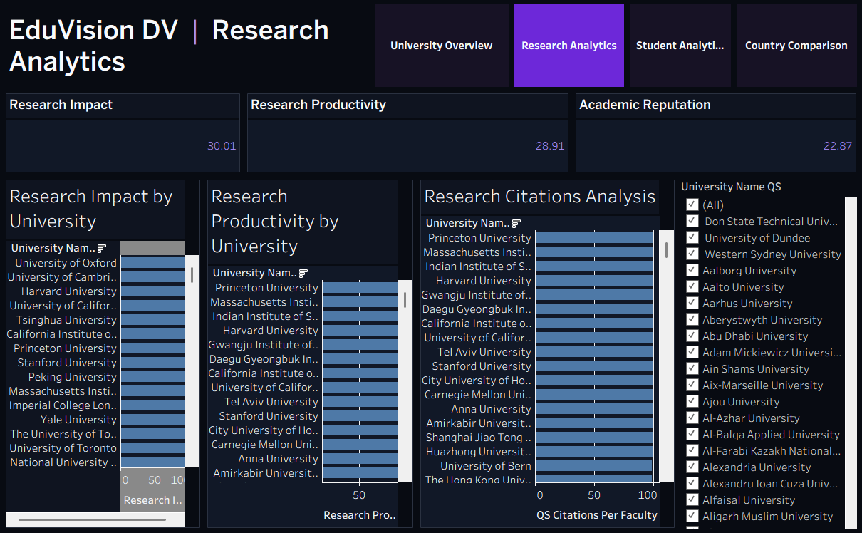
7. Milestone 3 — Research Analytics
Dashboard development: research impact, citations and productivity
EduVision DV • Higher Education Performance Dashboard
8

Slide 9
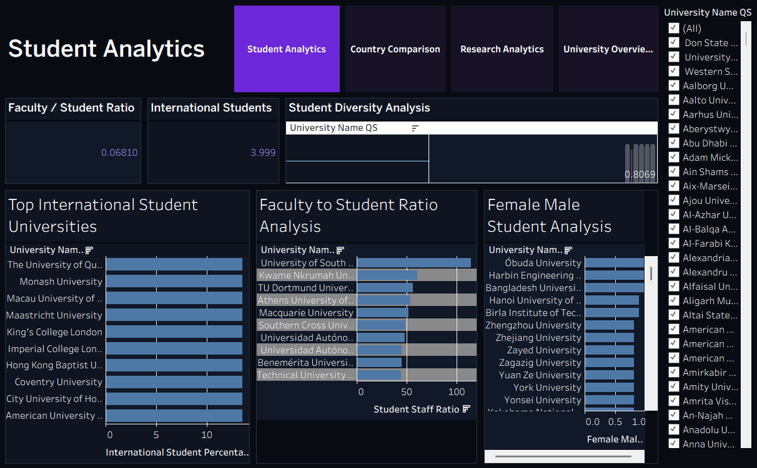
8. Milestone 3 — Student Analytics
Dashboard development: international students, diversity and faculty-to-student analysis
EduVision DV • Higher Education Performance Dashboard
9

Slide 10
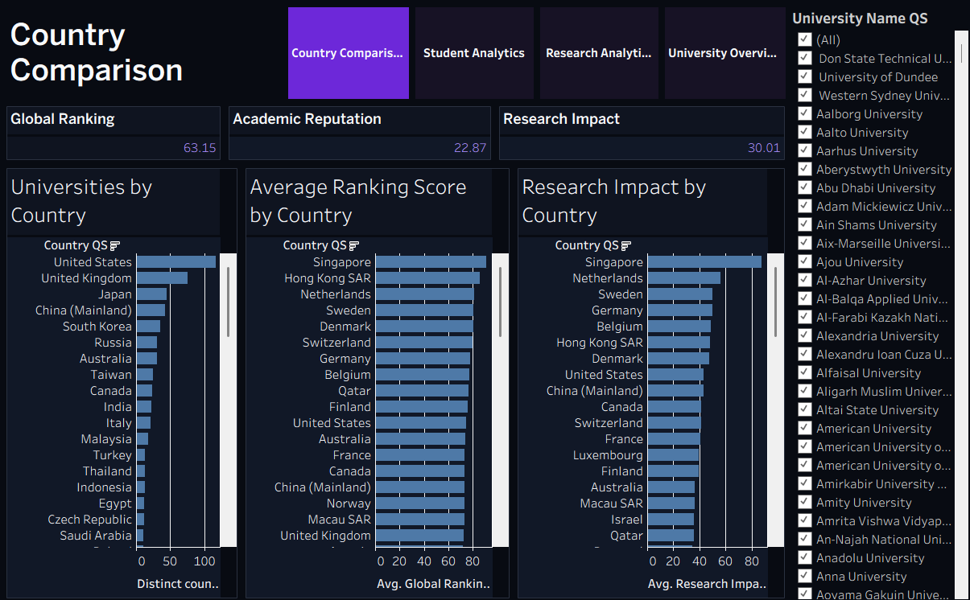
9. Milestone 3 — Country Comparison
Dashboard development: country-level benchmarking and performance comparison
EduVision DV • Higher Education Performance Dashboard
10

Slide 11
10. Dashboard Integration
Connecting the four dashboards into one Tableau experience
Global Filters
Navigation
Year, region/country and subject-area style filters support consistent exploration.
Users can move between Overview, Research, Student and Country views.
Actions
Unified Workbook
Interactive dashboard actions support comparisons and drill-down exploration.
All four dashboards are packaged together as one .twbx deliverable.
Final dashboard suite
University Overview | Research Analytics | Student Analytics | Country Comparison
EduVision DV • Higher Education Performance Dashboard
11

Slide 12
11. Milestone 4 — Testing, Validation & Delivery
Weeks 7–8
KPI VALIDATION
INTERACTION TESTING
DOCUMENTATION
Checked KPI calculations and ranking-related metrics against the prepared dataset.
Verified dashboard filters, navigation and interactive behavior.
Prepared project structure, dashboard guide, methodology and delivery materials.
Final project structure
/scripts
/data
/dashboard
/docs
Python / KPI generation
University datasets
Tableau workbook
QA, guide and documentation
EduVision DV • Higher Education Performance Dashboard
12

Slide 13
12. Final Outcome
What was delivered
DATA
ANALYTICS
VISUALIZATION
A Tableau-ready higher education dataset with 850 university records and engineered KPIs.
Six KPIs covering ranking, research, students and academic reputation.
Four integrated Tableau dashboards with filters, navigation and comparisons.
Key takeaway
EduVision DV converts complex university performance data into a simple, interactive dashboard suite that supports ranking analysis, research analysis, student analytics and country benchmarking.
Thank you
EduVision DV • Higher Education Performance Dashboard
13

